Slide 1
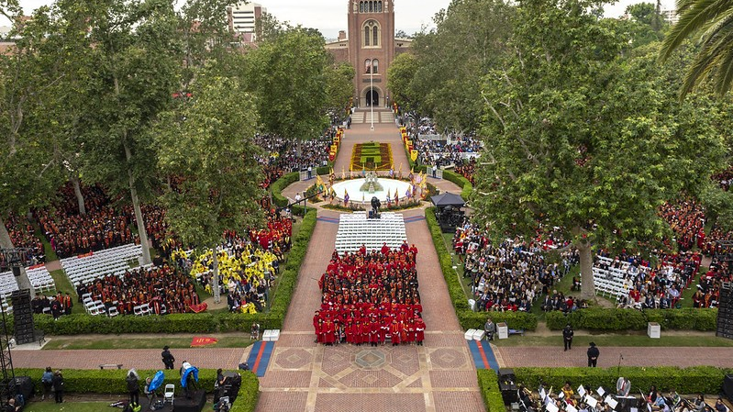
Foreign collaborations – Key considerations
FEBRUARY 2020

Slide 2
Executive Summary
US Government sponsors have expressed growing concerns regarding inappropriate influence by foreign entities over federally funded research and is requiring greater transparency from institutions and faculty.
In addition, the Office of Foreign Assets Controls (OFAC) imposes government sanctions on either specific individuals/entities, or country-wide sanction programs depending on destination.

Slide 3
FROM THE HEADLINES
Institutions and researchers have faced stiff penalties in the last year for failure to appropriately disclose outside foreign relationships.
MD Anderson – April 2019
NIH Investigations
MD Anderson ousts three senior researchers after NIH discovers “serious” violations of peer review confidentiality rules and failure to disclose foreign activities in China.
As of October, 2019, NIH has investigated at least 180 scientists at more than 65 institutions. In part, NIH is using publicly available information from publications to determine who to investigate. Largest number of cases are focusing on transfers of data to China, Russia, and Iran.
University of Kansas – August 2019
Harvard University – Jan 2020
Professor indicted for allegedly failing to disclose full-time employment contract with Chinese university. If convicted, he faces up to 20 years imprisonment and several hundred thousand dollars in fines.
Charles Lieber, Chemistry Department Chair, arrested for failing to disclose extensive participation in Chinese “1000 Talents” program.

Slide 4
Sponsors speak up
March, 2019: The Department of Defense (DoD) issued a memo outlining disclosure requirements, to include listing all current projects the individual is working on, level of commitment associated with those projects, and total support received.
June, 2019: Department of Energy (DoE) issued a directive mandating contractors to fully disclose, and as necessary, terminate affiliations with government-supported talent recruitment programs.
July, 2019: NIH issued guidance reminding research institutions that NIH-funded researchers must “report foreign activities through documentation of other support, foreign components, and financial conflict of interest to prevent scientific, budgetary, or commitment overlap”.
July, 2019: NSF issues a Dear Colleague letter outlining its plans to “address emerging risks to the nation’s science and engineering enterprise”.
October, 2019: DoD issues a second memo asking the university community to assist in developing solutions and best practices regarding foreign threat awareness and information sharing.
December, 2019: NSF releases a report by independent science advisory group (JASON) titled “Fundamental Research Security” analyzing the nature of the threat to research security.

Slide 5
USC approach
June, 2019: Office of Research issues FAQ’s regarding faculty disclosure obligations to the university and to sponsors of outside activity, including activity abroad.
November, 2019: USC Global, Office of Research, and Office of Ethics and Compliance issue memo providing guidance on disclosure obligations and restrictions on activities in certain countries under Department of Treasury regulations (OFAC)
In partnership with the Office of Research, perform several assessments with faculty who have foreign relationships to provide guidance regarding appropriate scope and disclosure obligations.

Slide 6
Recommended practices
Foreign components of federally-funded research should be disclosed on proposals, progress reports, and final technical reports.
A “foreign component” is defined as “any significant scientific element or segment of a project outside of the United States…whether or not grant funds are expended”, including collaborations that:
May result in co-authorship
Involve use of facilities or instrumentation at a foreign site
Result in receipt of financial support or resources from a foreign entity.
Multiple ways in which foreign components can be disclosed:
Disclosing a “foreign component” in a grant application
Listing a “non-US performance site”
Identifying foreign relationships and activities in a biosketch
Checking “yes” to the question on the Cover Page supplement Form asking: “Does this project involve activities outside of the United States or partnerships with international collaborators?”
Financial resources should be disclosed even if they relate to work that is performed outside of a researcher’s appointment period (e.g. summer for 9-month faculty)

Slide 7
Recommended practices (cont.)
USC researchers should disclose all applicable “Other Support” as required by federal sponsors.
Other support may include resources and/or financial support, from domestic or foreign sources. Such support should be disclosed on an “Other Support” or “Current & Pending” form.
Examples of other support include:
Grants and contracts
Gift funding
Faculty or other positions or appointments, regardless of remuneration
Participation in “foreign talent programs” such as China’s Thousand Talents Program.
All current projects and activities that involve senior/key personnel, even if support is only in-kind (e.g. office/laboratory space, equipment, supplies, employees).
Consult with the Office of Ethics and Compliance if you are unclear about whether an outside activity must be disclosed as “other support”.

Slide 8
Recommended practices (cont.)
USC researchers must adhere to existing university policy on Conflicts of Interest.
USC policy requires that researchers disclose certain outside relationships for review prior to engaging in the activity. Please keep the following in mind:
Faculty are not permitted to conduct research at other institutions without an exceptional approval from the applicable Dean and VP of Research.
Academic titles (regardless of title) at a domestic or foreign institution require approval of the Executive Vice Provost for Faculty Affairs, upon recommendation of the appropriate Dean.
Disclosure of consulting payments and ownership interests that benefit from research being conducted at USC.
Annual reporting of all significant financial interests is required of HHS-supported faculty.
All outside relationships that might create an appearance of a conflict of interest must be disclosed via “diSClose”, USC’s on-line disclosure system (disclose.usc.edu).
Consult with the Office of Ethics and Compliance for guidance on your disclosure obligations under USC’s Conflict of Interest policies.

Slide 9
But wait…there’s more (OFAC)
Under Department of Treasury regulations administered by the Office of Foreign Assets Control (OFAC), certain individuals, entities, and countries are subject to economic sanctions.
As a result, depending on the person, entity, or country, collaborations may be either limited (requiring specific authorization from OFAC in the form of a license) or prohibited entirely. This can include even basic research collaborations intended to be shared in the public domain (so-called “fundamental research”).
Countries that are comprehensively sanctioned include Iran, Cuba, North Korea, Sudan, Syria, and others.
China, while not subject to comprehensive sanctions, has seen increased numbers of entities and individuals placed on OFAC sanction lists in recent years.
All collaborations, institutional or individual, with OFAC-sanctioned countries, entities, or individuals, must be disclosed to the Office of Ethics and Compliance and appropriate licenses from OFAC obtained where required prior to undertaking collaboration.

