Slide 1
Let’s Talk
(Electronic) Communication
Best practices for use toward our successful navigation through, and adaptation to, the University’s culture change.

Slide 2
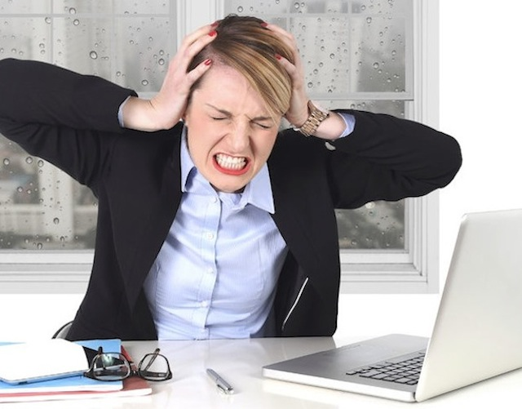
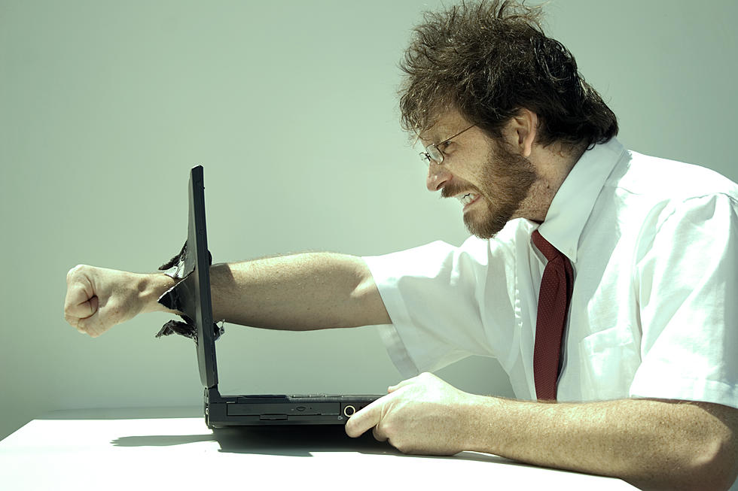
Morse code
Ineffective vs Effective (electronic) communication
trust
productivity
hostility
morale
relationships
confusion
misunderstandings
job satisfaction
comradery
ambiguity
conflict

Slide 3
Tin cans and strings
What weakens (electronic) communication?
lack of specificity
lack of clarity
lack of respectful responses/rebuttals
lack of appropriate tone
lack of focused attention
lack of directness
humor/sarcasm

Slide 4
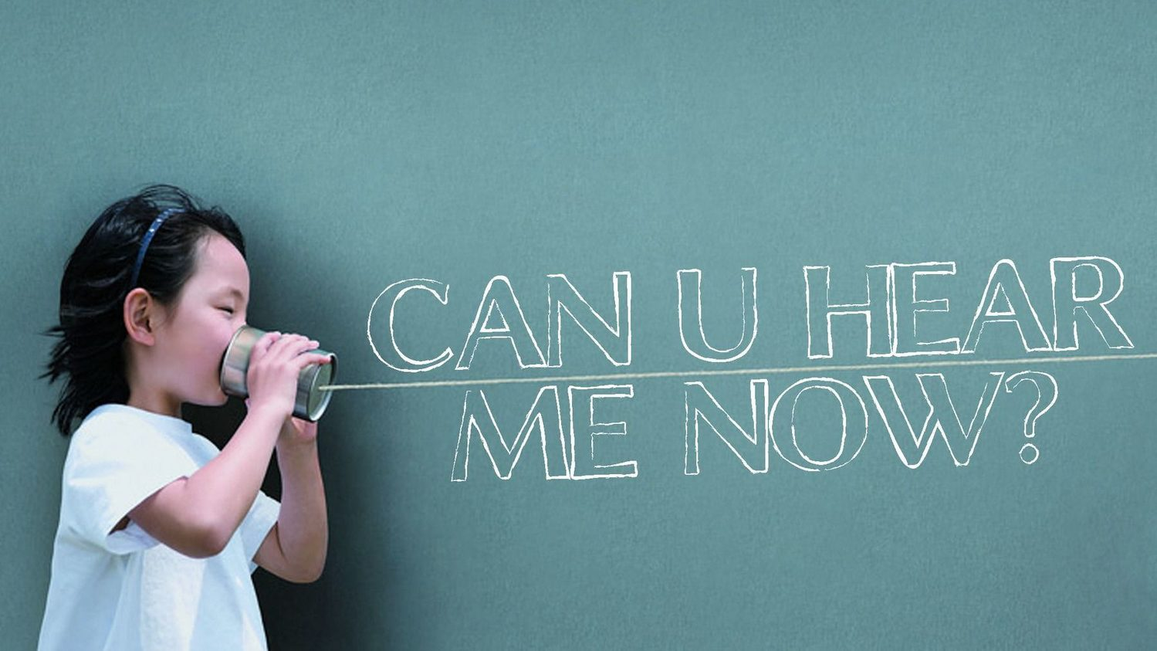
Can you hear me now?
What strengthens (electronic) communication?
brief and precise subject
“To” = action
“Cc” = reference
when forwarding, add value
“Reply All” with discretion
use “Urgent” sparingly
message is necessary, accurate and complete
professional tone only
know when to pick up the phone

